Slide 1

Alter-Learning Connect Hub Web and Application Desktop Windows / MACOS

Slide 2
Use Cases
Overview
Server
Desktop Client

Slide 3
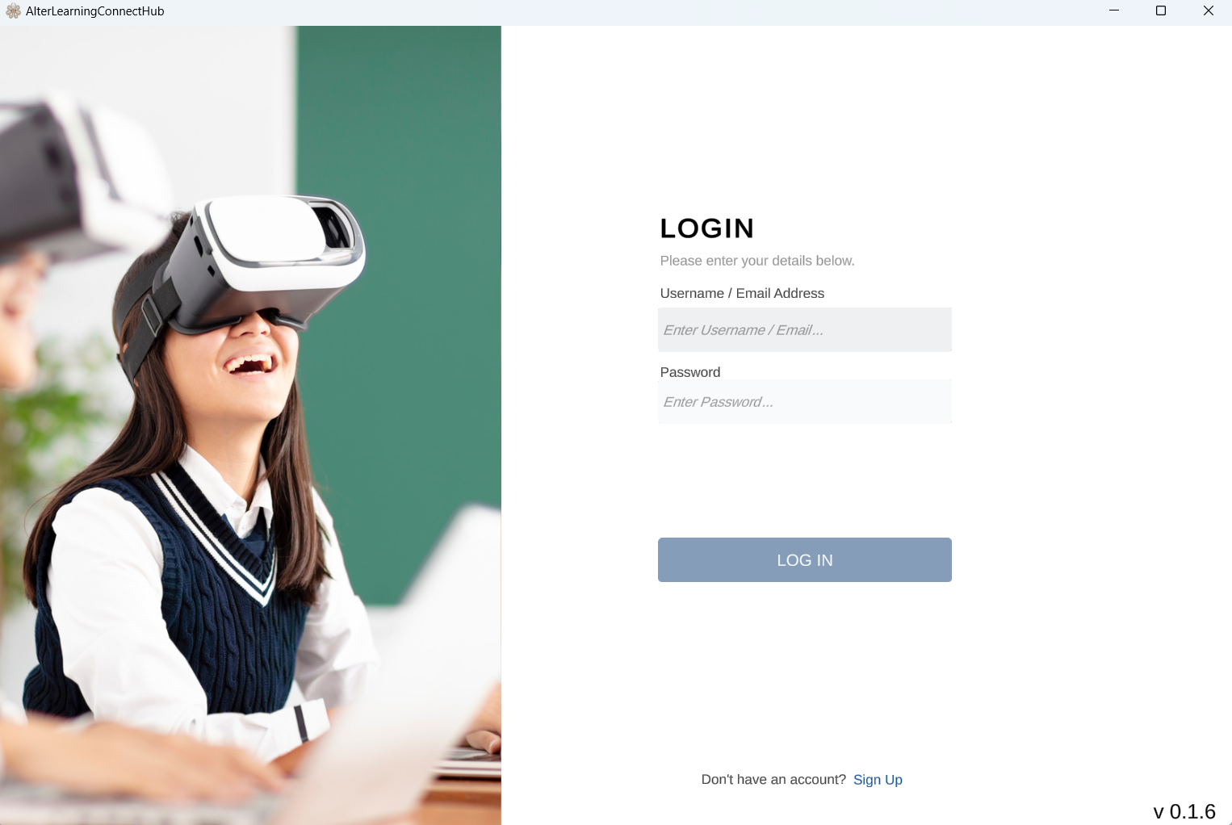
LOGIN

Slide 4
After Animation
Short Menu is
AL Platform
AL HUB (UI Slide 7)
AL Connect
Exit

Slide 5
AL Platform - STORE (AL Store)
List of All or filtered list of Edugames / XR Rooms available in AL Store and not installed in the device or AL Connect Hub

Slide 6
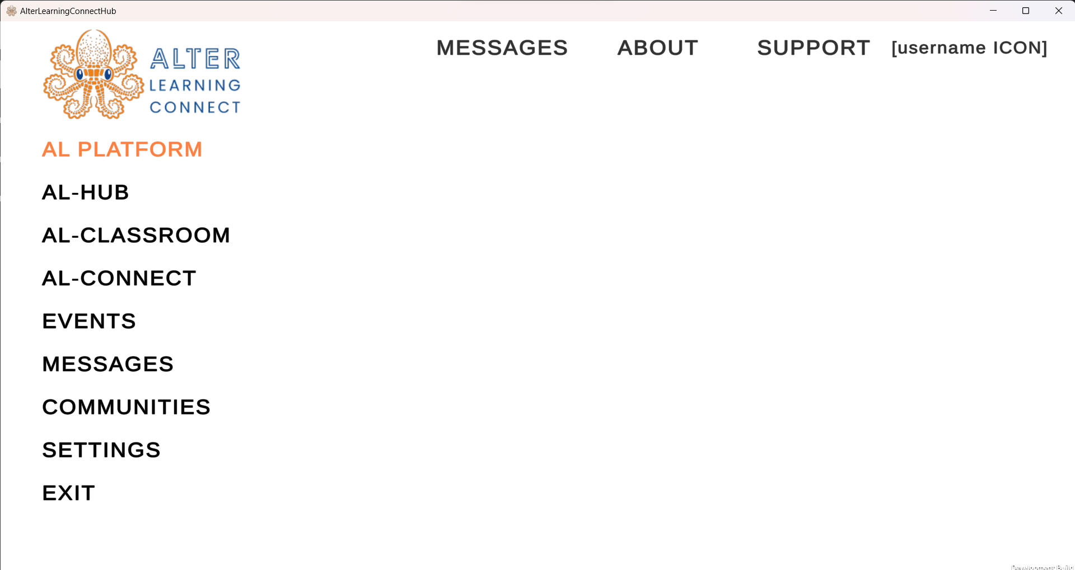
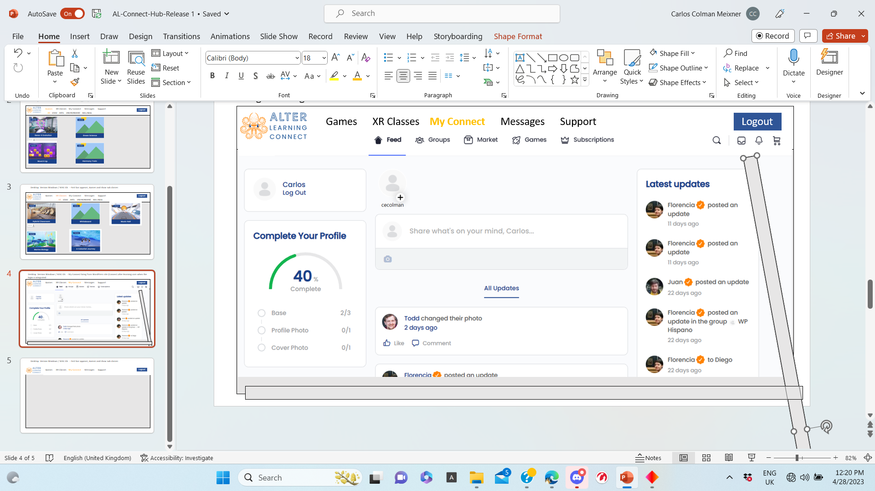

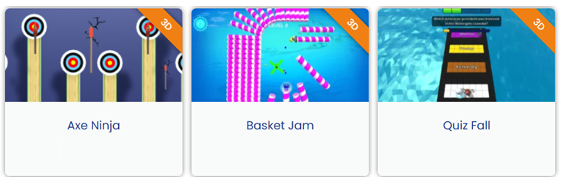
Filter of type of game or XR Rooms
(Welcome to AL Connect)
(Play or create an AL Room)
(Access to my profile)
Change in visualization (no important for now)
STORE LIBRARY EVENTS
ALL / Educational Games / XR Rooms - More Details
Visualization ( Bigicons, Small icons, details)
CONTENT MANAGER OF BUILDS INSTALLED (NOT URGENT) Secundary if we have time
SESSIONS
Axe Ninja
Basket Jam
Quiz Fall
INSTALL
Include in your plan
INSTALL
Include in your plan
Not Include in your plan please
STORE option (Alter-Learning Store) Includes Games / XR Rooms (ALL OFFERED BY AL) Including not installed, available for user plan and not available in the user plan or for the user operating system)
(Similar to Release R2 but without the option RUN IT FROM HERE) only install if is allowed

Slide 7
AL Platform - LIBRARY (My AL LIBRARY)
List of All or filtered list of Edugames / XR Rooms installed in the device with the option to remove and update.

Slide 8
Filter of type of game or XR Rooms
(Welcome to AL Connect)
(Play or create an AL Room)
(Access to my profile)
Change in visualization (no important for now)
STORE LIBRARY EVENTS
ALL / Educational Games / XR Rooms - More Details
Visualization ( Bigicons, Small icons, details)
CONTENT MANAGER OF BUILDS INSTALLED (NOT URGENT) Secundary if we have time
SESSIONS
Axe Ninja
Basket Jam
REMOVE
REMOVE
LIBRARY option (My Alter-Learning Library) Includes Games / XR Rooms (INSTALLED IN THE HUB, CLIENT SIDE)
(Similar to Store option and R2 option without the option to RUN IT FROM HERE). When the game or xr room is removed must disappear from this list. It might have a flag confirming the removal. Also the Update option is not available when the release is the last release.

Slide 9
AL Platform - EVENT
List all events as host or as invited to Eduplay Session or XR room.

Slide 10
Filter of type of game or XR Rooms
(Welcome to AL Connect)
(Play or create an AL Room)
(Access to my profile)
If I am Host, I will start the event or room selected so I going straight to AL-3D-HUB inside the room
STORE LIBRARY EVENTS
ALL / Educational Gam / XR Rooms - More Details
SESSIONS
CONTENT MANAGER OF BUILDS INSTALLED (NOT URGENT) Secundary if we have time
NEW
(play or create AL ROOM)
JOIN
START
EDIT
DELETE
REFRESH
SELECT | ID | AL-HUB | TYPE | GAMES & XR ROOM | DESCRIPTION | DATE/TIME | HOST | PARTICIPANTS | STATUS
[ ] | {SESSION ID – ROON ID} | [WEB] [2D] [3D/VR] | [CASSUAL] [EDU-PLAY] [LESSON] | [CASSUAL GAME1] [XR-ROOM 1] [EDU-GAME 1] [EDU-GAME 2] | {DESCRIPTION} | {DATE:TIM | {Username} {Institution} {Family} | [Username1} + | [Not Started} [In progress] {Ended}
Join the event go directly to the AL-HUB Looby of the Given room
1) NEW / EDIT you create/edit an event
2) It will show the even details
Select the event if exist
Create an event or casual educational play
Refresh data
Delete the Event
Edit a not started event / Room

Slide 11
AL Platform - EVENT – NEW Event / PLAY
Form to Play by default or for create a join event.

Slide 12
(Welcome to AL Connect)
(Play or create an AL Room)
(Access to my profile)
If I am Host, I will start the event or room selected so I going straight to AL-3D-HUB inside the room
Create an event or casual educational play
STORE LIBRARY EVENTS
NEW AL EDU-XR SESSION
AL-HUB : WEB/2D - 3D – 3D/VR
TYPE: - CASSUAL - EDU-PLAY - LESSON
DESCRIPTION: (Optional)
PARTICIPANTS: NONE – INVITE
GAMES & XR-ROOMS : CASSUAL GAMES – EDU-GAMES - XR-ROOMS
Axe Ninja
Basket Jam
Quiz Fall
[ ]
UPDATE
[ ]
UPDATE
[ ]
CREATE
CANCEL
Delete the Event

Slide 13
AL HUB - Joining as Host
UI – Robot with the option to personalize and update content if needed.

Slide 14
AL LIBRARY M Y LIBRARY MY EVENTS
ALL/ Educational Games / XR Rooms - More Details
SESSIONS
TOTAL STORAGE USED (KB): TOTAL (Number of Builds) UPDATED (NUMBER) NOT UPDATED (NUMBER)
Check all
[ ]
Axe Ninja
X Mbytes
UPDATE
REMOVE
Include Games / XR Rooms Are Installed Locally
The games will appear only if you installed
3) Details including the storage and release date of last install/update

Slide 15

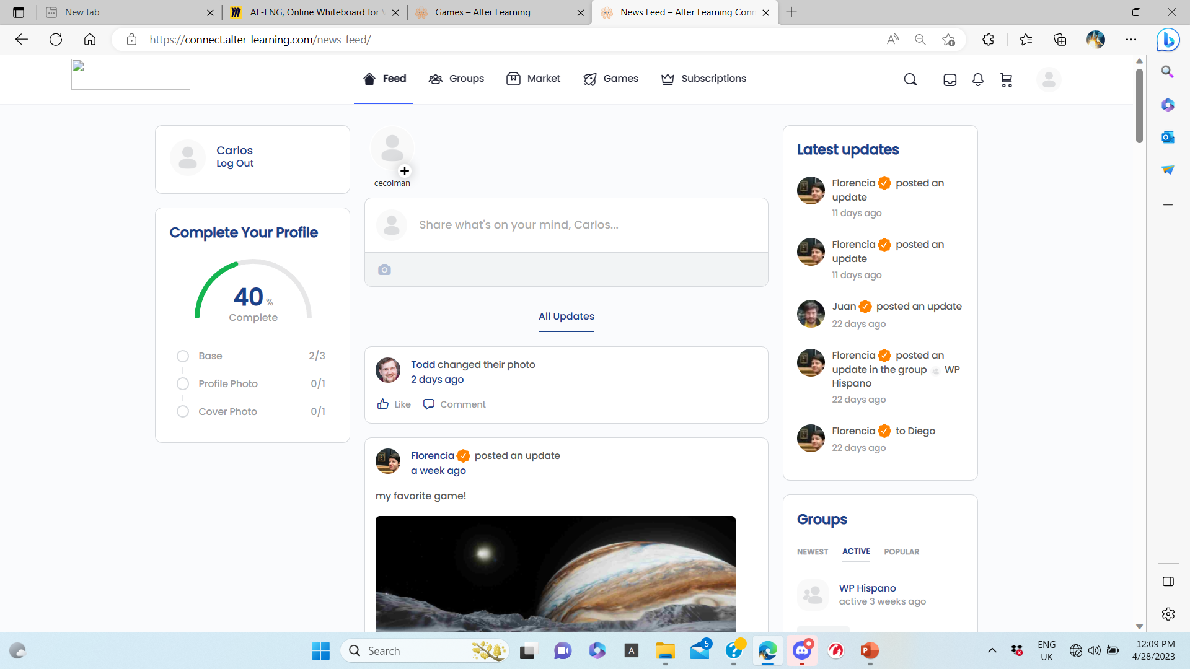
http://ser.backend.alter-learning.com:2567SA
ABOUT SUPPORT MESSAGES Welcome [Username]
NEW AL EDU-XR SESSION
DATE&TIME: NOW – SCHEDULE
TYPE: - CASSUAL - EDU-PLAY - LESSON
AL-HUB : WEB/2D - 3D – 3D/VR
PARTICIPANTS: NONE – INVITE
ROSTER:
DESCRIPTION: (Optional)
GAMES & XR-ROOMS : CASSUAL GAMES – EDU-GAMES - XR-ROOMS
Axe Ninja
UPDATE
SELECT
ACCEPT
CANCEL

